Slide 1
Lecture 2
Data Structures – Queues, Stacks, and linked list

Slide 2
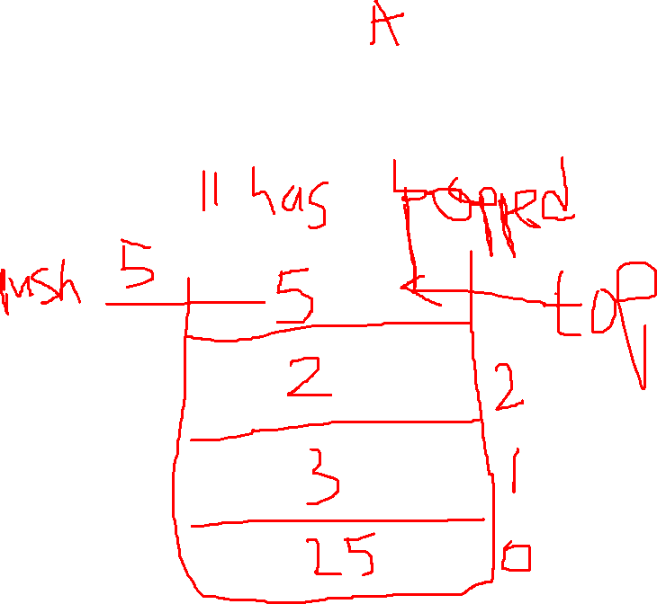
Stacks
This is a data structure that uses LIFO(last in – first out) principle

Slide 3
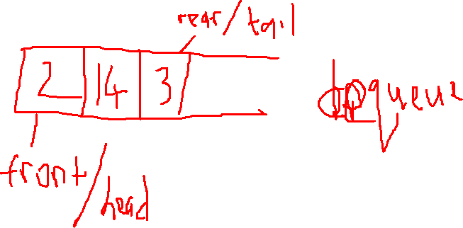
Queues
This is kind of the opposite of stacks. They use the FIFO(First in – First out) principle

Slide 4
Linked list
This is a data structure that has nodes which store a value and the location of the next node.
We have the singly, doubly, circular linked lists etc

